Slide 1
EVENT MANAGEMENT
INFORMATION SYSTEM
(EMIS)
EVENT MANAGEMENT
INFORMATION SYSTEM
(EMIS)

Slide 2
Prototype Overview
Aononto Jahan Junnurain
Dept. of CSE, IUBAT

Slide 3
INTRODUCTION
Eventura is an event management platform.
Users can easily select events, book venue and make payments.
The prototype demonstrates all the main interactive features.

Slide 4
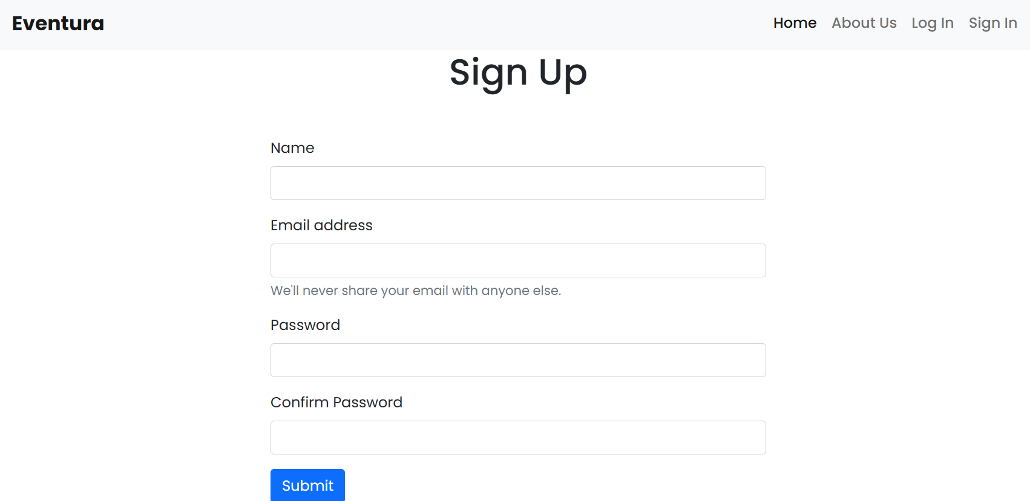
USER SIGN UP
Allows new users to create an account using email Simple and user-friendly form design.
Ensures secure user registration.
Visual: Screenshot from the prototype showing the Sign Up interface.

Slide 5
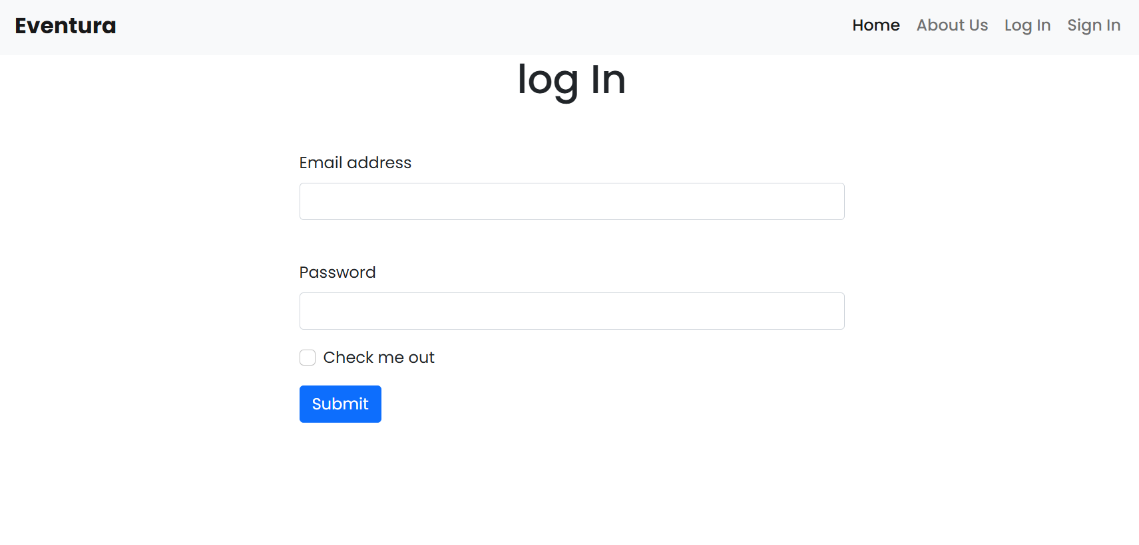
USER LOG IN
Enables registered users to access their account.
Options for email/password login or social login.
Maintains secure authentication.
Visual: Screenshot from the prototype showing the Log In interface.

Slide 6
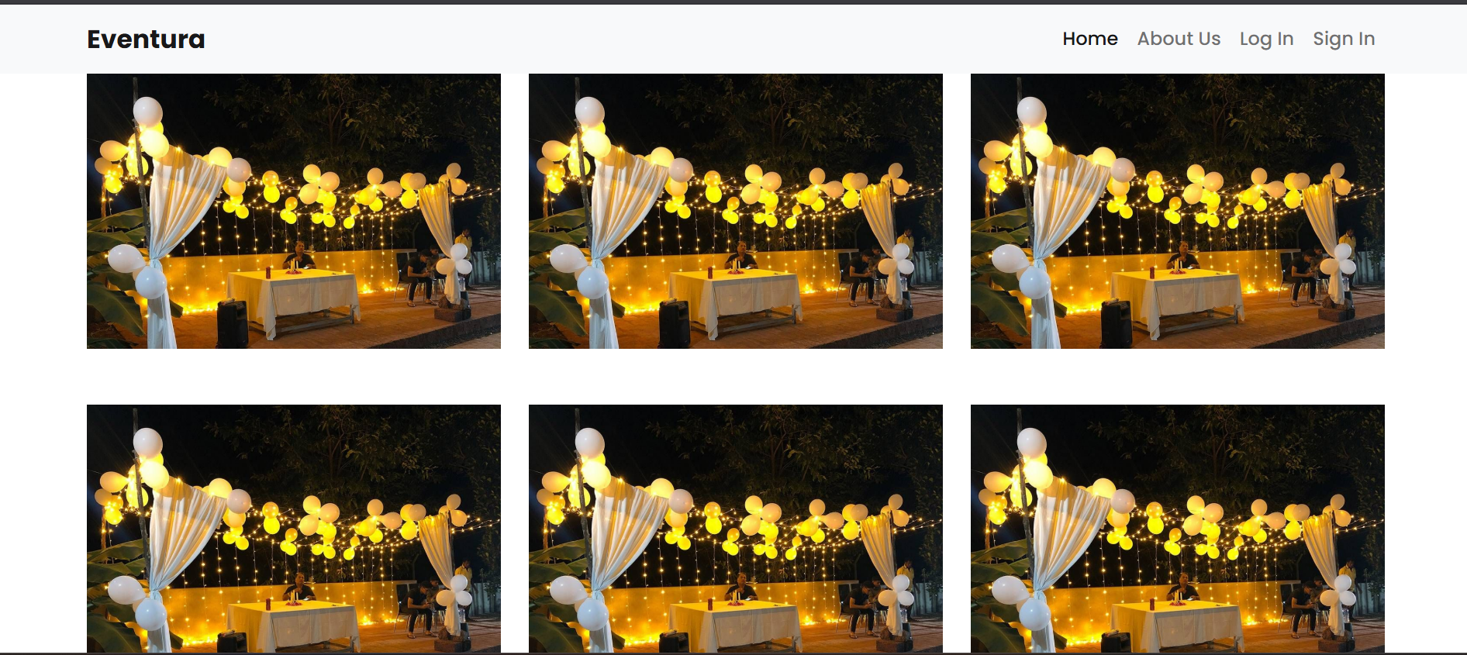
PHOTO GALLARY

Slide 7
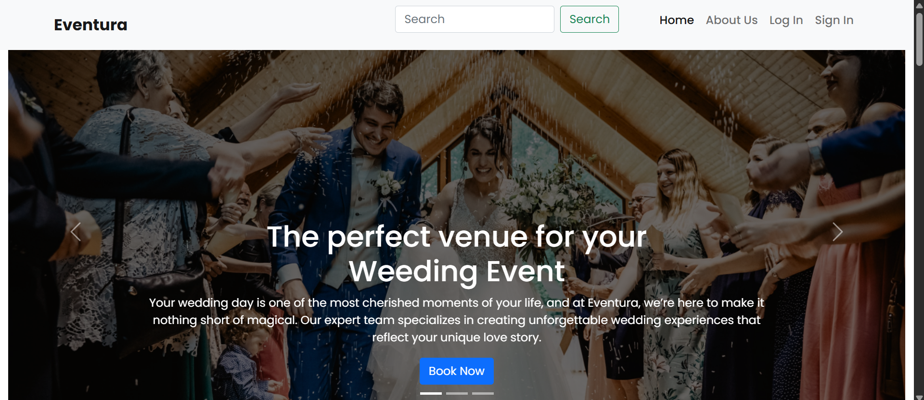
HOME PAGE
Button placement: prominent and user-friendly.
Visual: Include a screenshot from the prototype showing the Book Now button. Allows users to book an event directly after selection.
Step-by-step booking process is clear and simple.

Slide 8
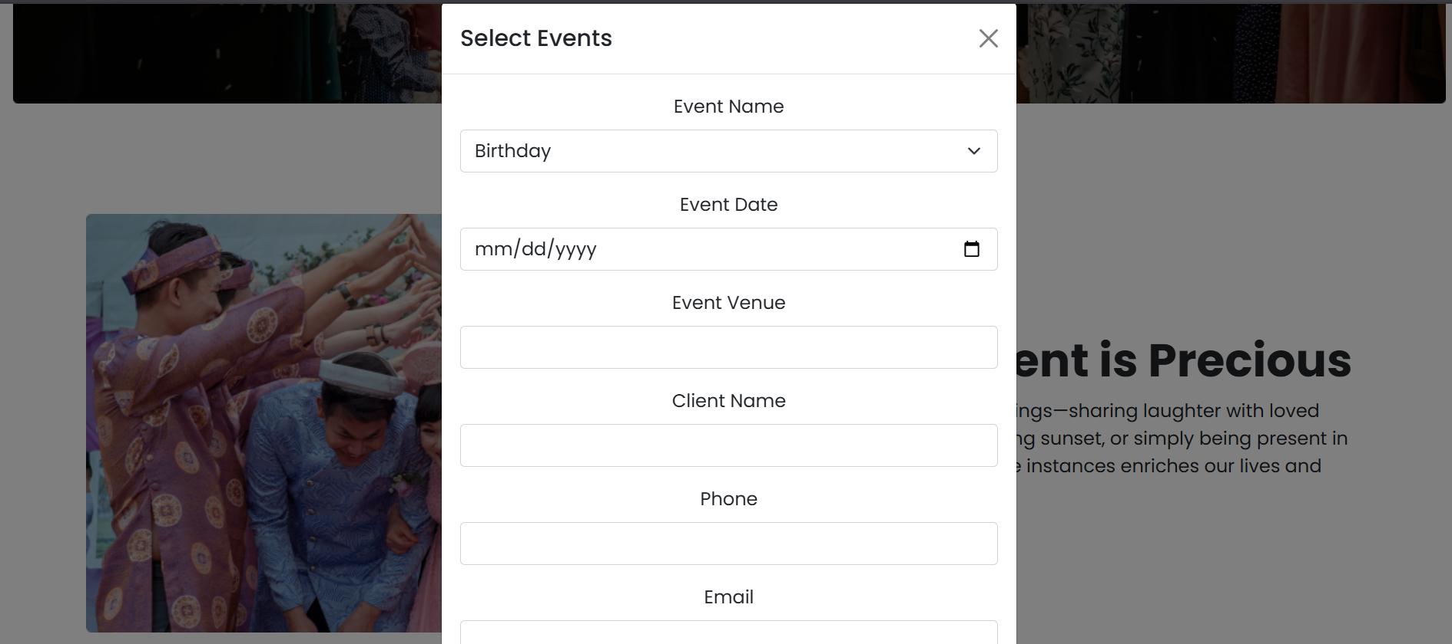
BOOKING PROCESS

Slide 9
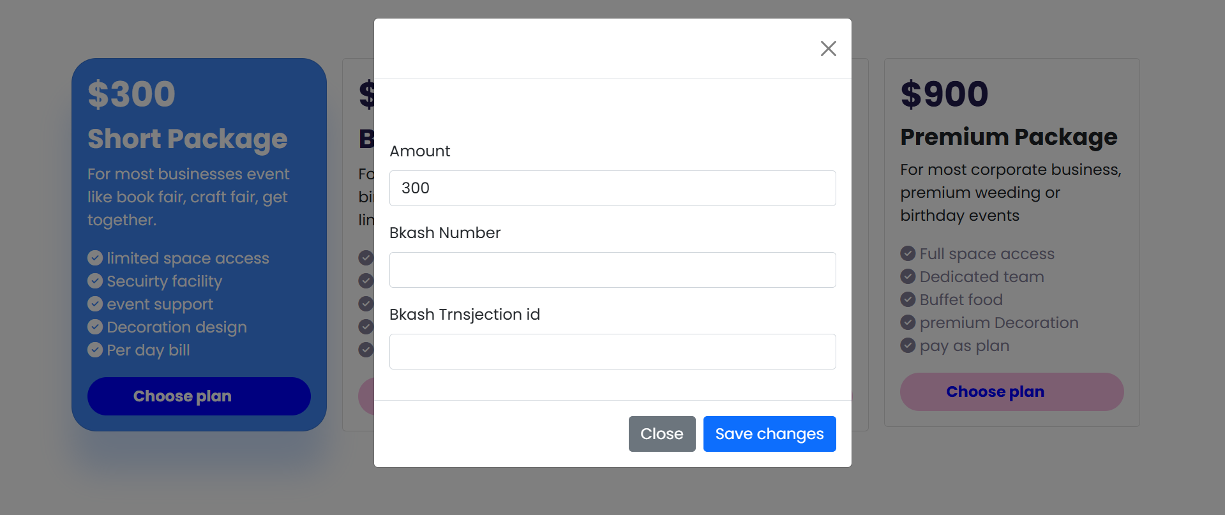
PAYMENT OPTION

Slide 10
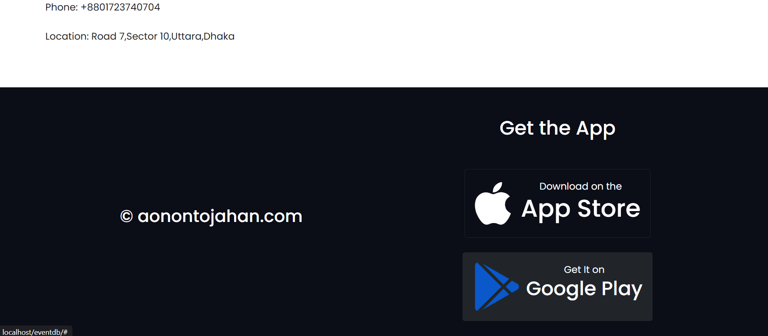
APP VERSION

Slide 11
THANK YOU

